Slide 1
Final Project
MAE 6430

Slide 2
The Plan
Explore several of the ideas in Chapter 11
Compare to results to some shown in Adrian, 2007

Slide 3
The Assignment
Download Adrian 2007 from Canvas
Download the vector fields from Canvas 7_3_11_Forced…zip.
Using these data, reproduce the turbulent parts of figure 1 a and b from Adrian. The probability distribution functions (fig 1b) should be made for y+ = 5, 10, 100 and 500.
Find the wall shear stress value by curve fitting a Spaulding profile. See Kendal2008. Plot the mean streamwise velocity in wall coordinates.
Find the mixing length as a function of position in the boundary layer
Write a short paper in AIAA or ASME format that describes these results and the methods you used to obtain them.
I will answer questions up until April 23rd.

Slide 4
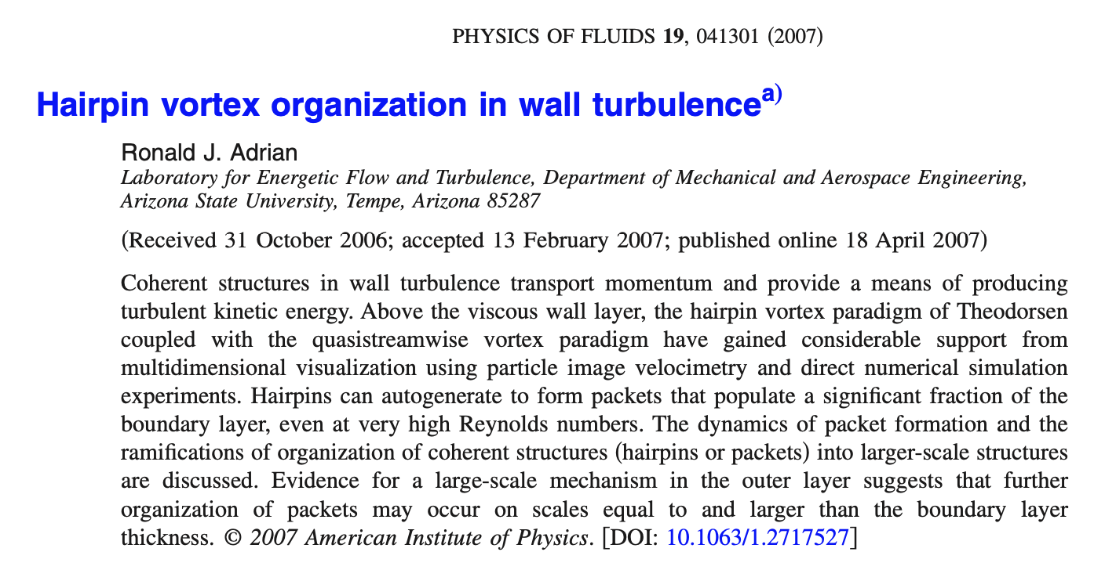
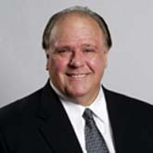

Adrian, 2007

Slide 5
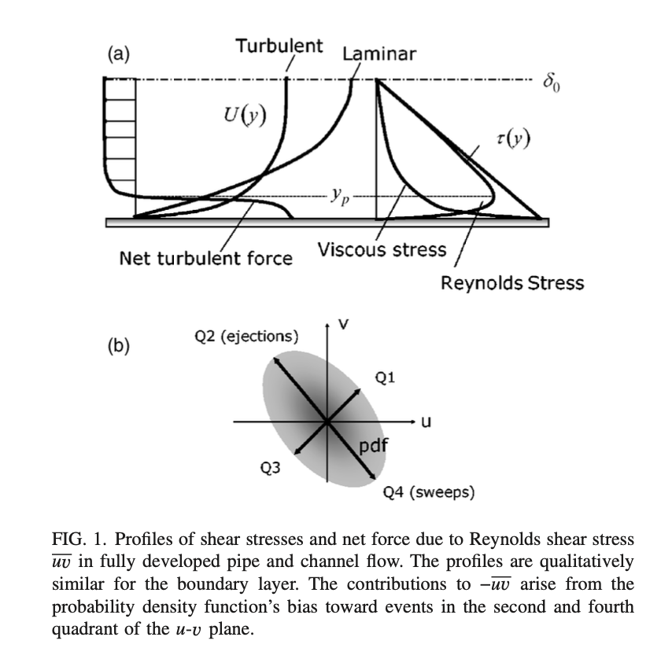
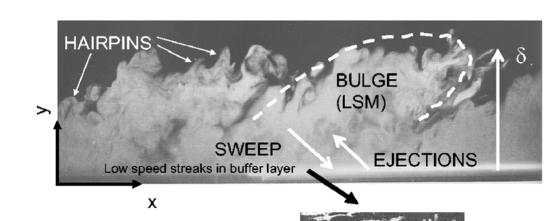

Slide 6
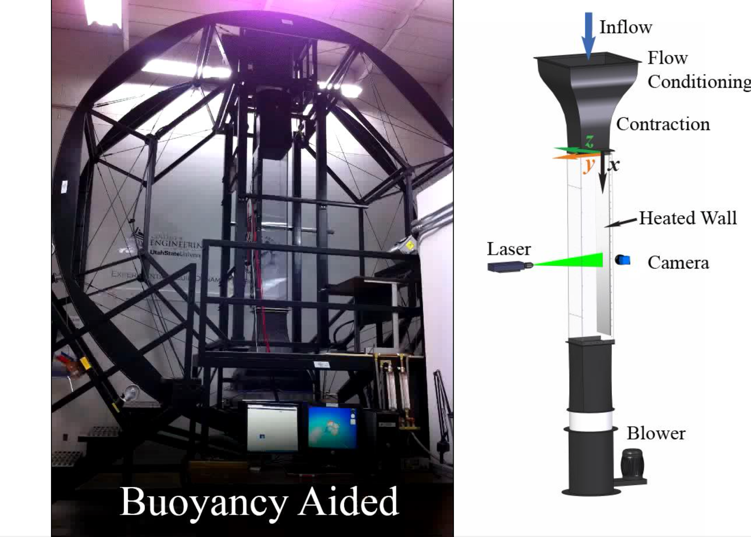
The Experiment

Slide 7
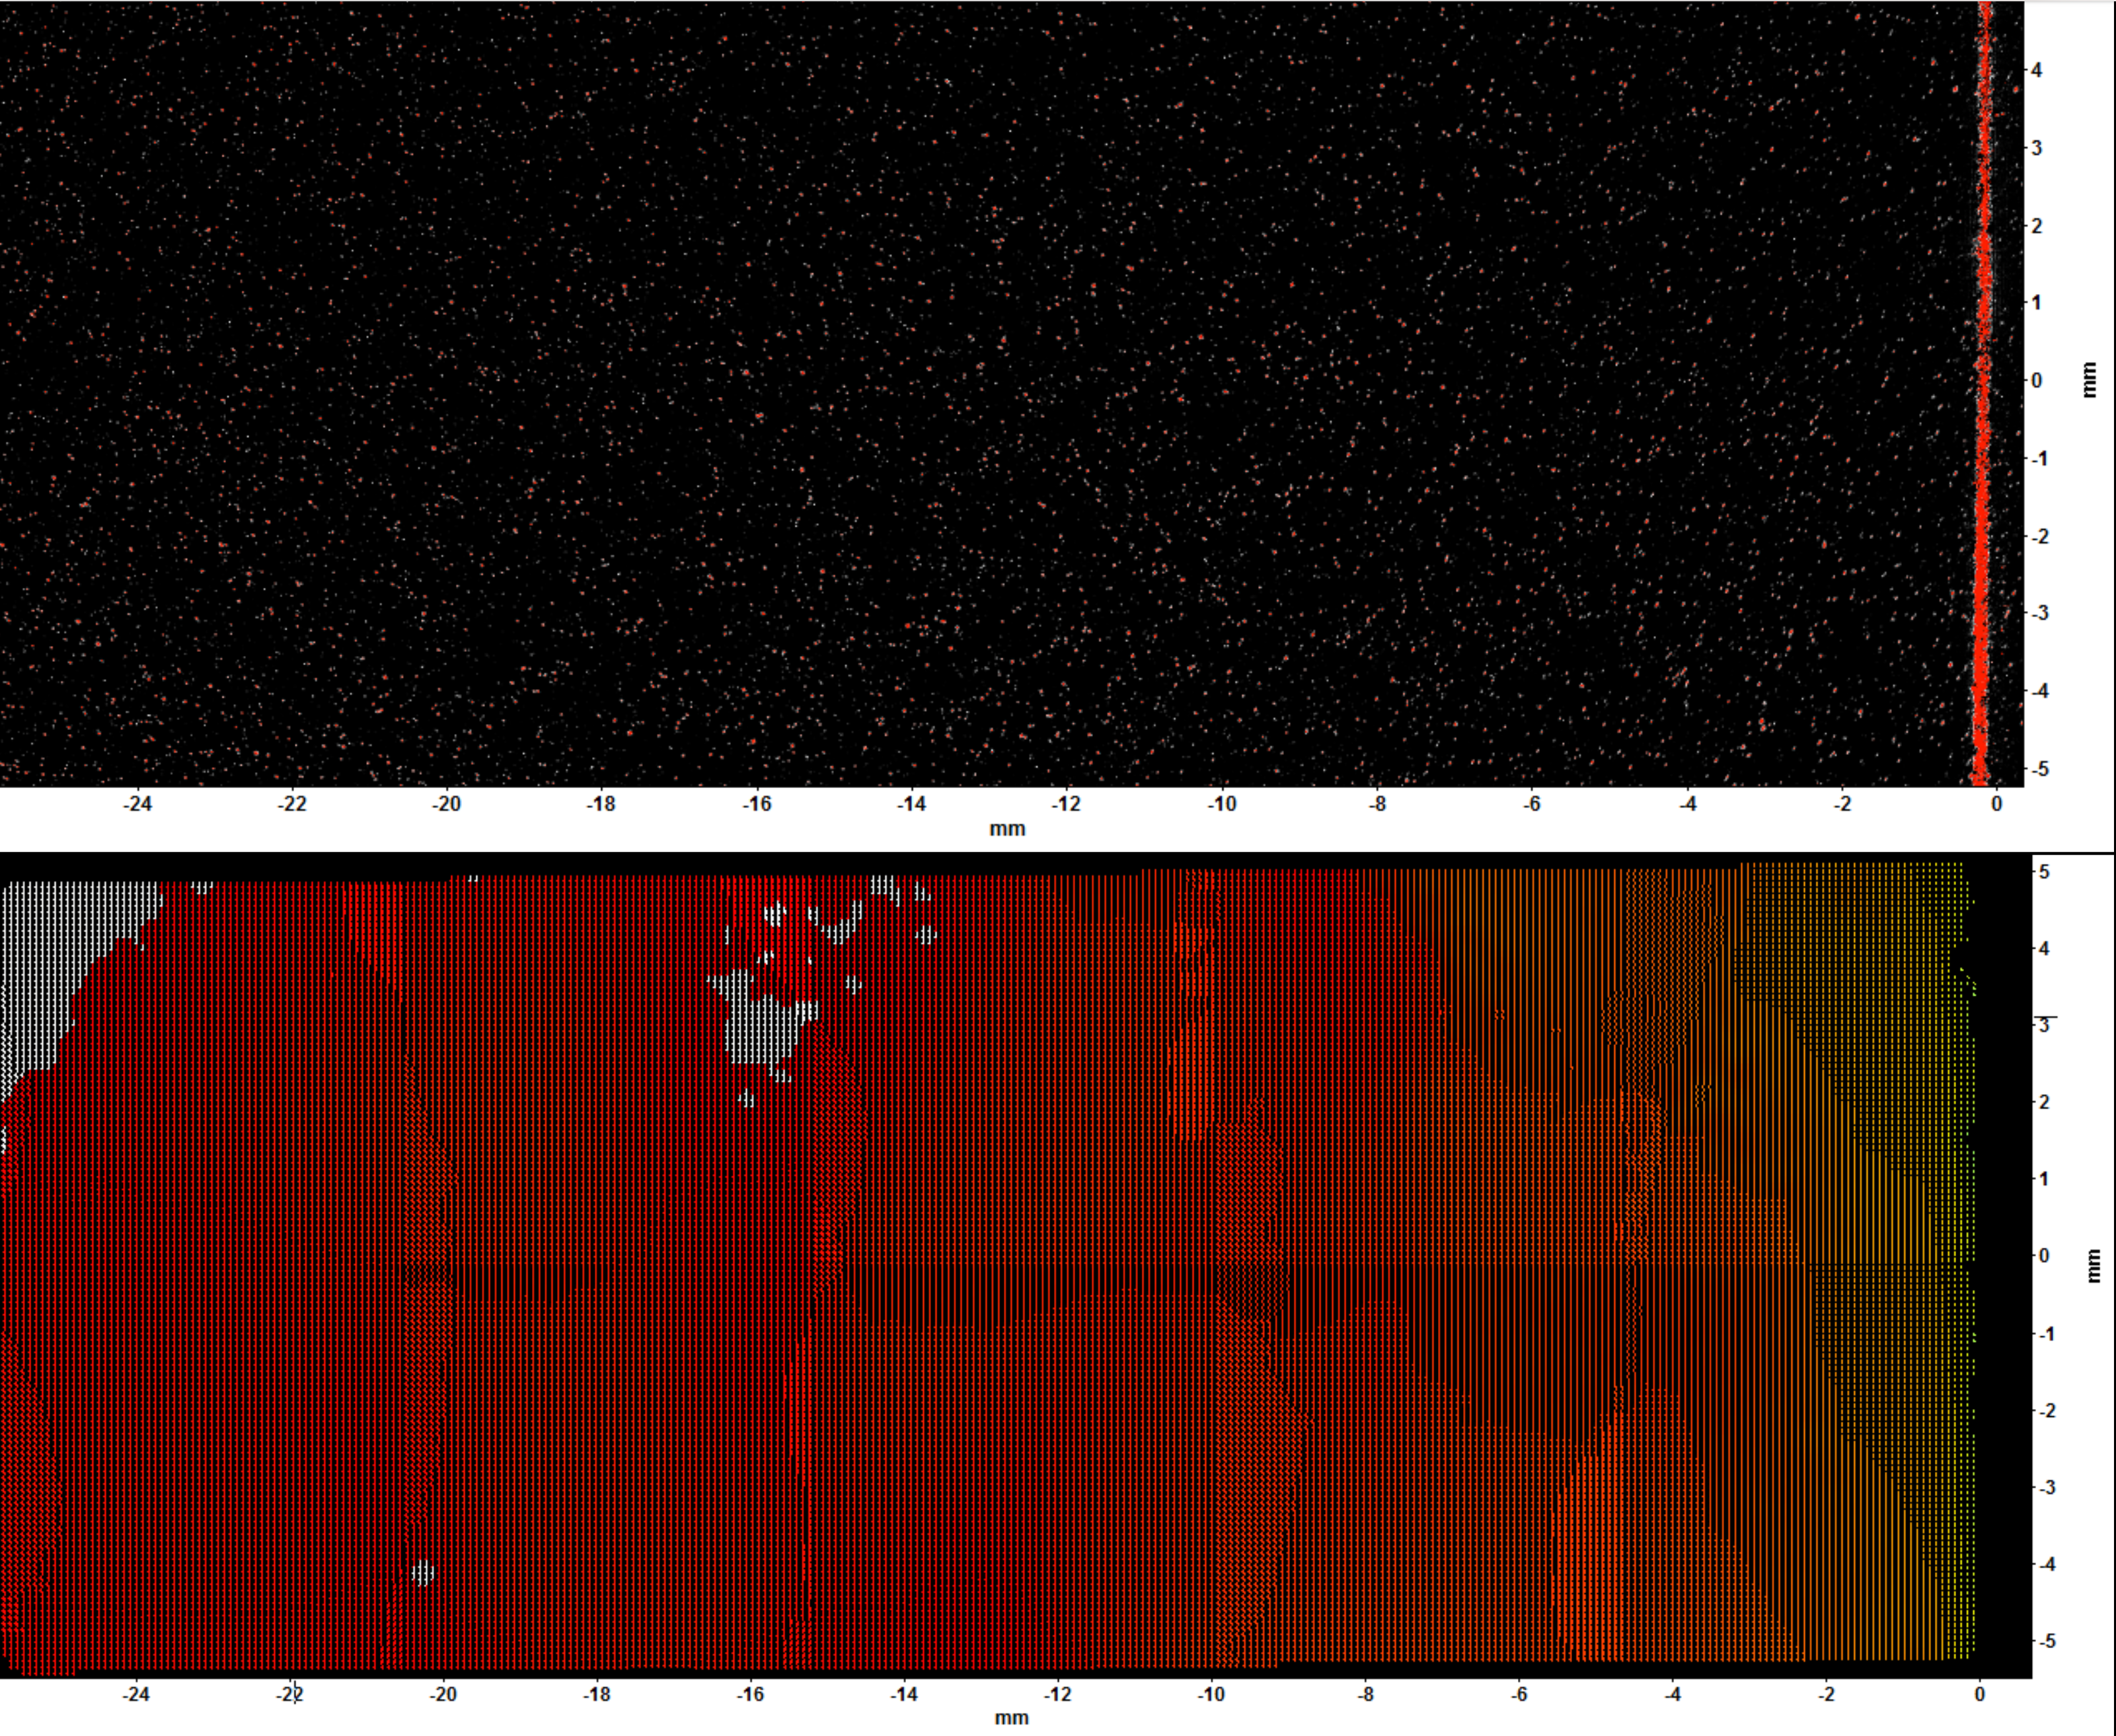
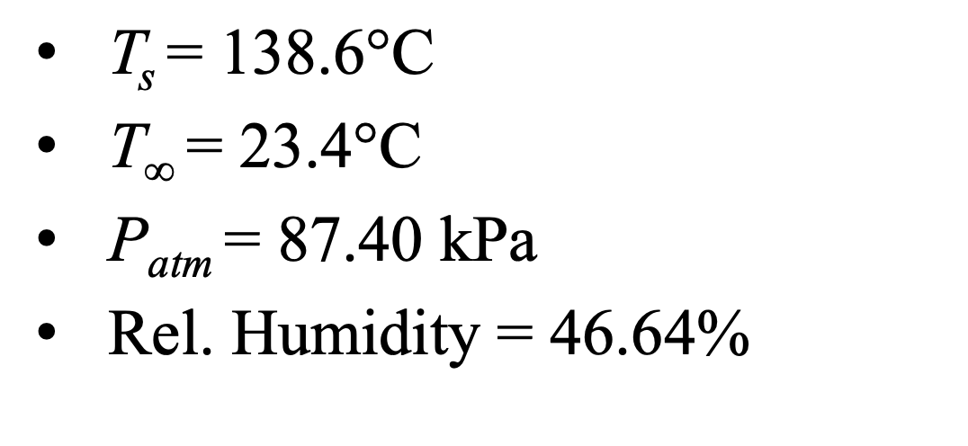
The Data

Slide 8
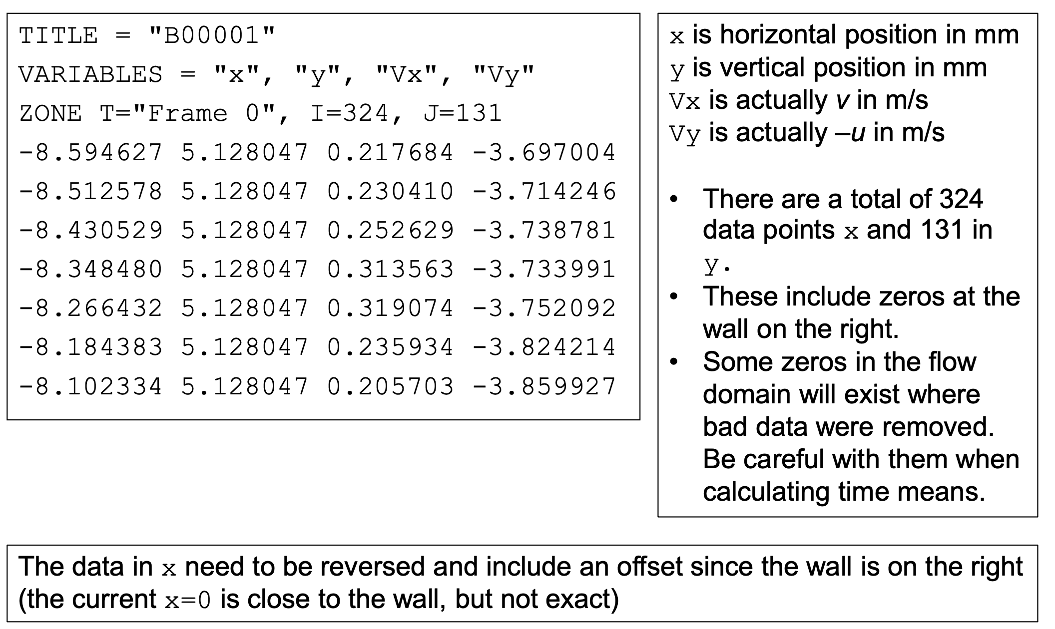
The Data
Tecplot format
Snapshots in time

Slide 9
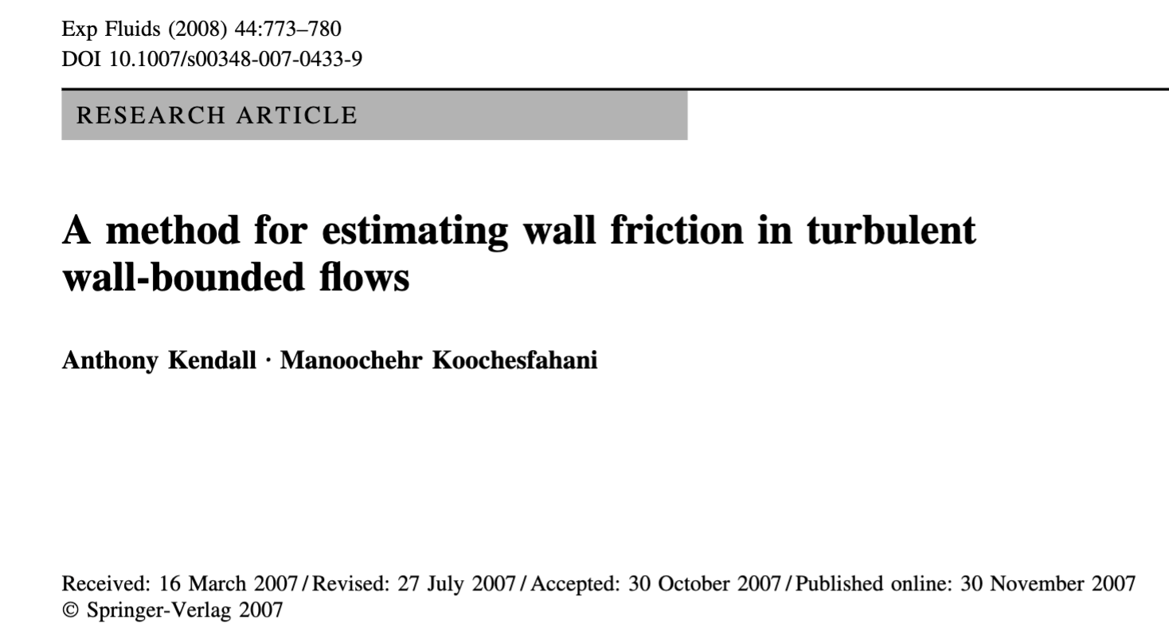

Velocity Profile
For wall coordinates, must find the wall shear stress
It is not directly measure
But for a smooth surface, you can infer it from a fit of the velocity data
This is described in Kendal

Slide 10
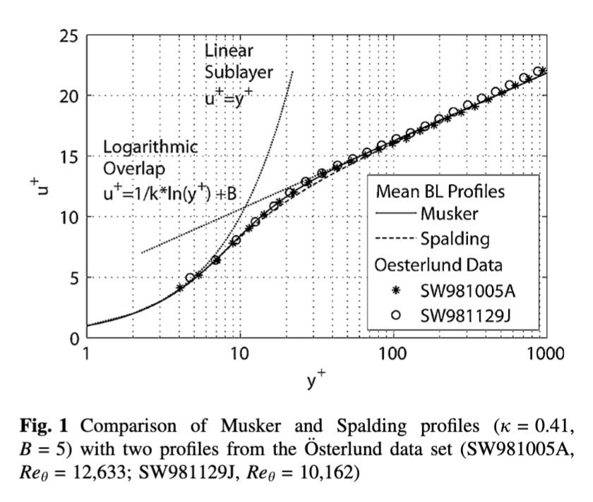
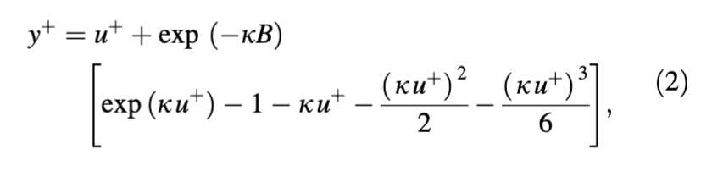

Slide 11
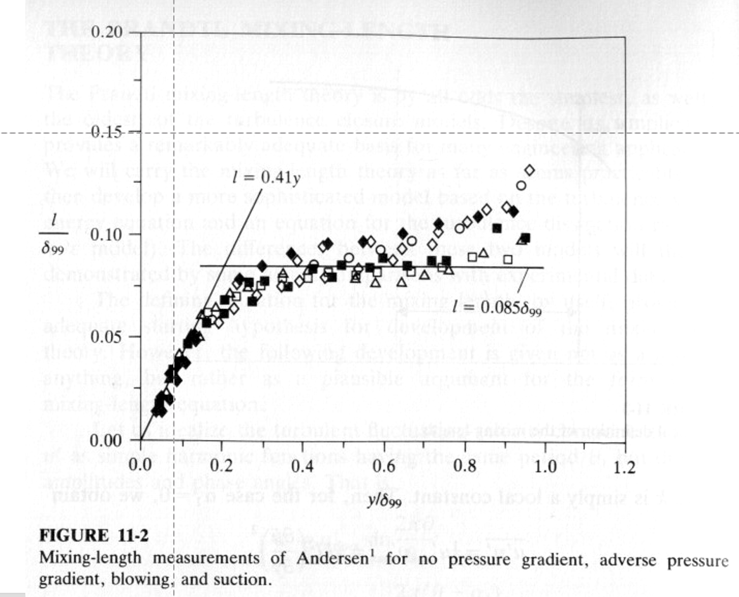
Mixing Length Model

